Slide 1
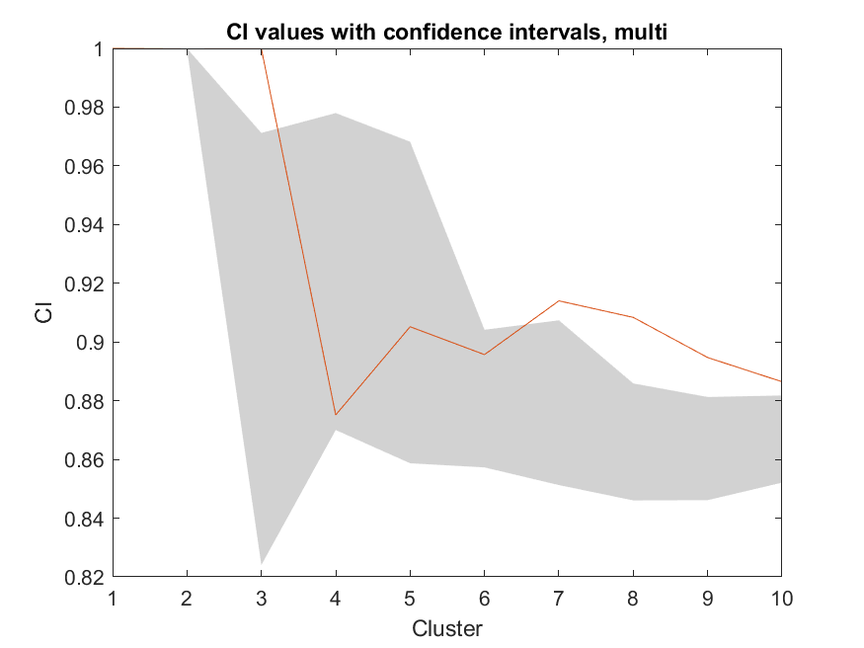
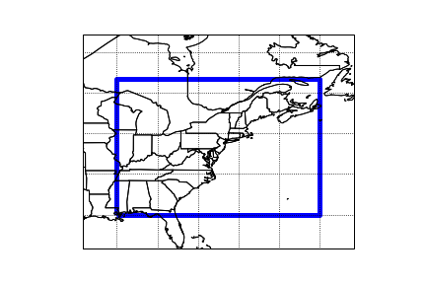
Figure 1. Bounding box of the area of study (left). K-means analysis results, grey shading indicates the 90% confidence interval.

Slide 2
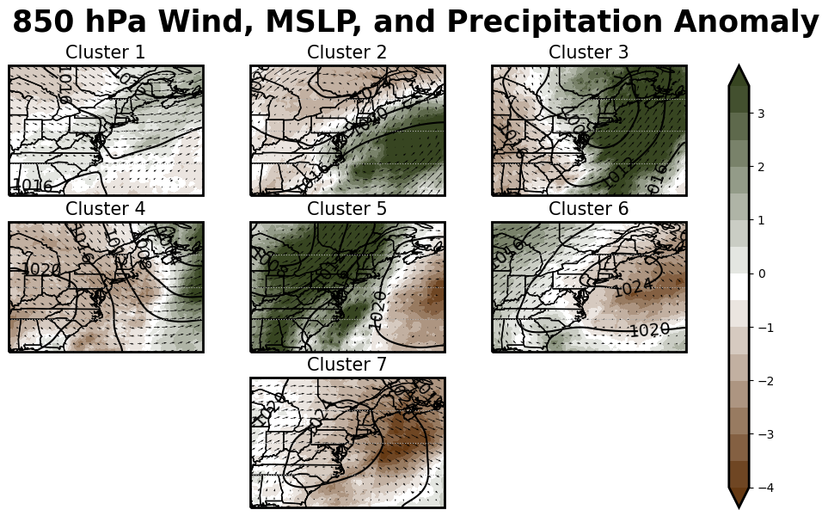
Figure 2. WTs with 850 hPa u and v winds and Means Sea Level Pressure (contour) shown. Average precipitation per WT (mm/day) is shaded.

Slide 3
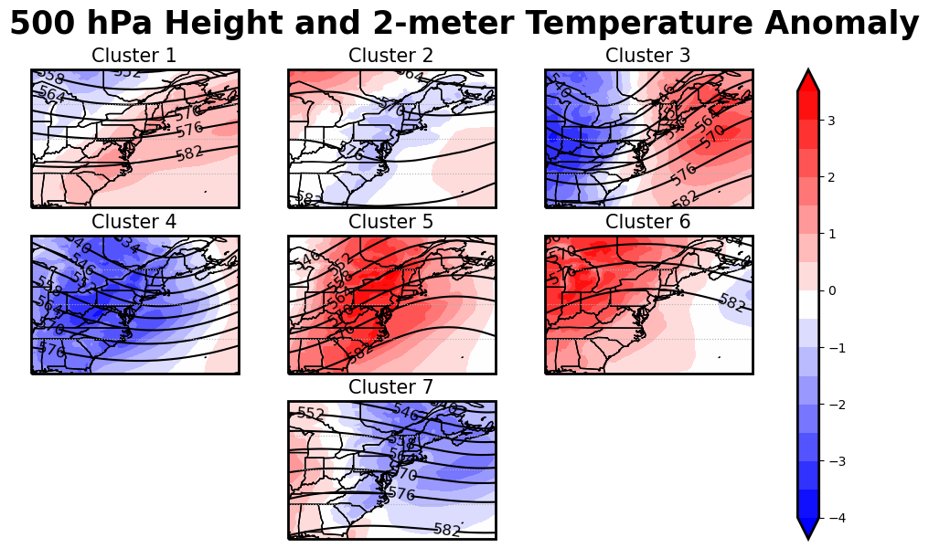
Figure 3. WT 500 hPa heights (contour) and 2-meter temperature anomalies (shaded).

Slide 4
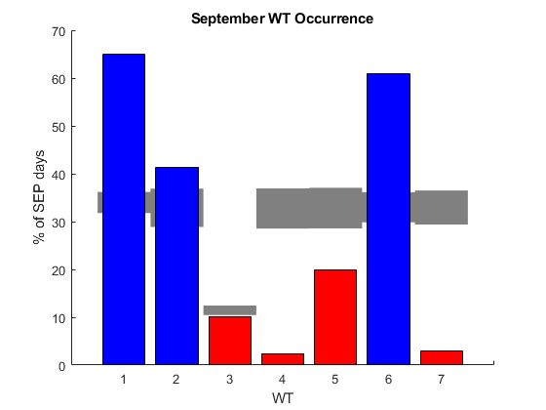
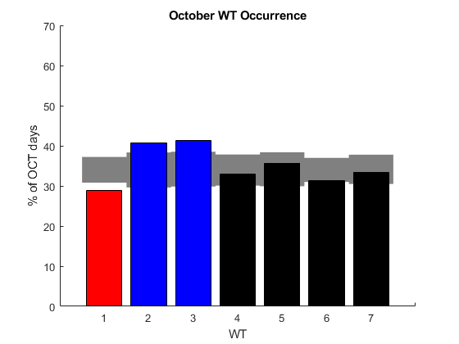
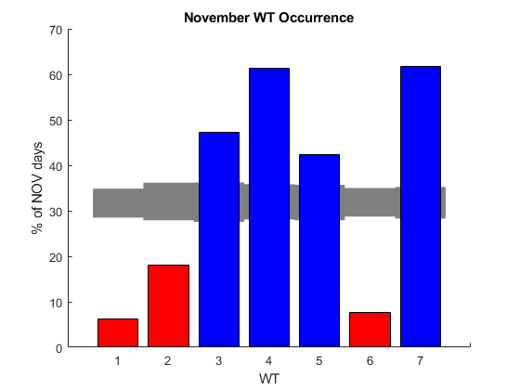
Figure 4. Monthly frequency of each WT. Grey bars indicate the 95% confidence interval, with red shading indicating WTs that are less likely to occur and blue shading indicating WTs that are more likely to occur.

Slide 5
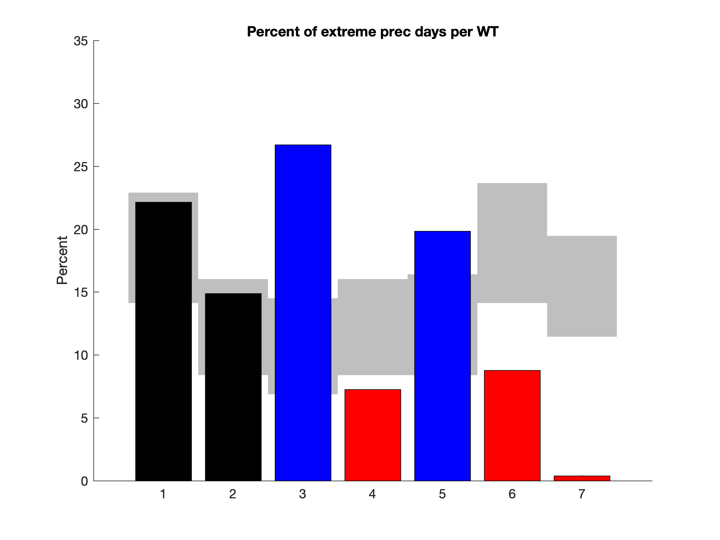
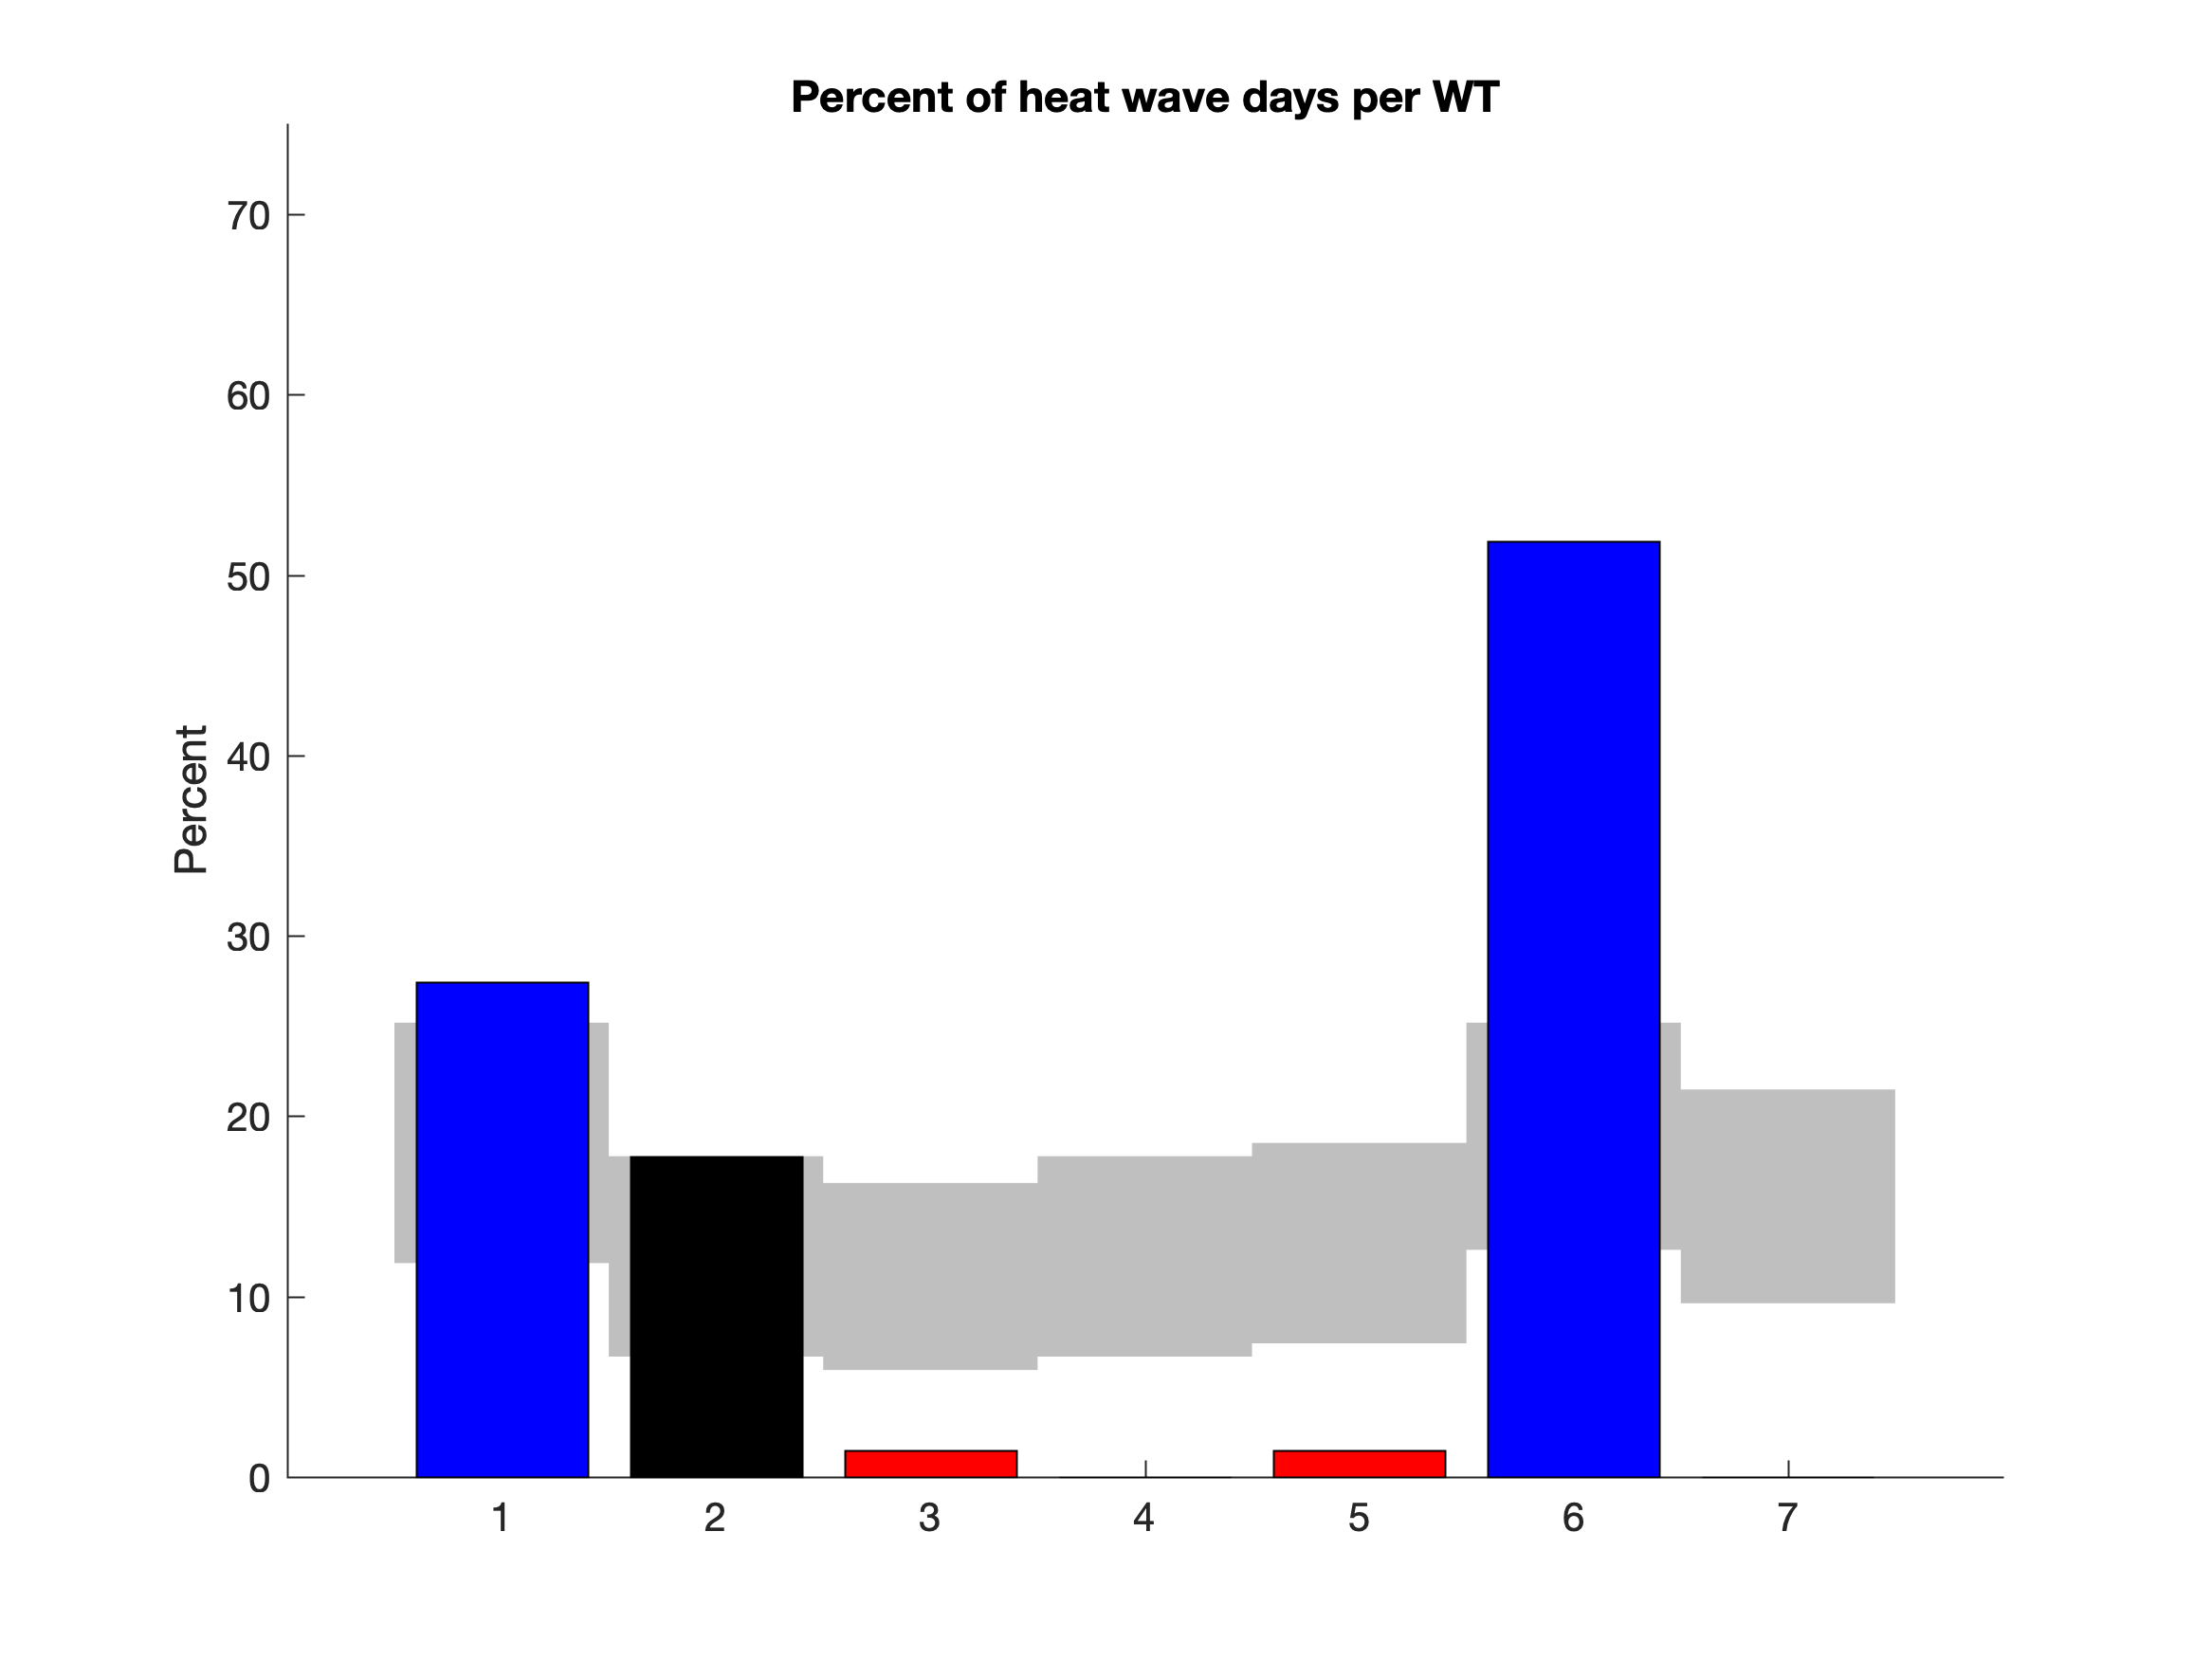
Figure 5. Percent of WT days featuring extreme precipitation (left) and heat waves (right). Grey shading indicates the Monte Carlo 95% confidence interval, with red shading indicating less likely to occur WTs and blue shading indicating more likely to occur WTs.

Slide 6
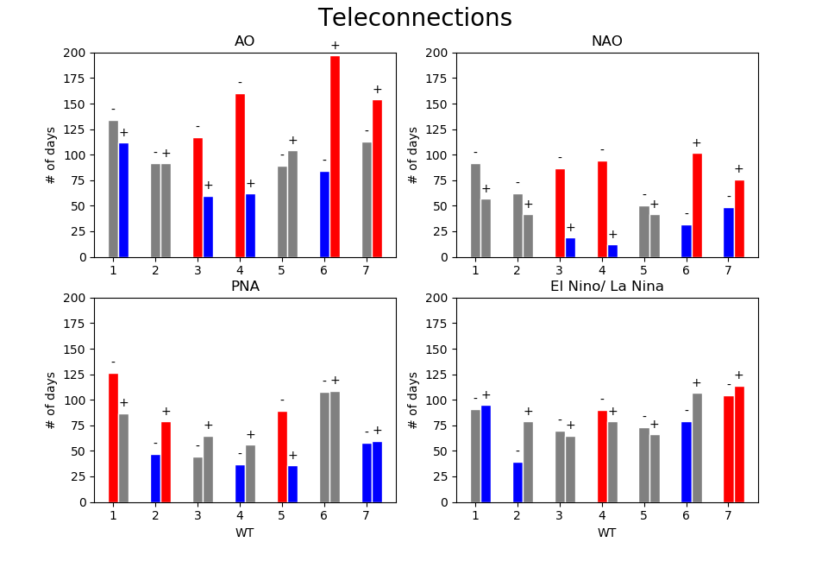
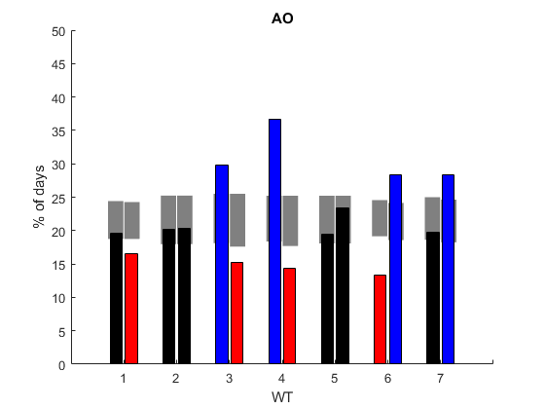
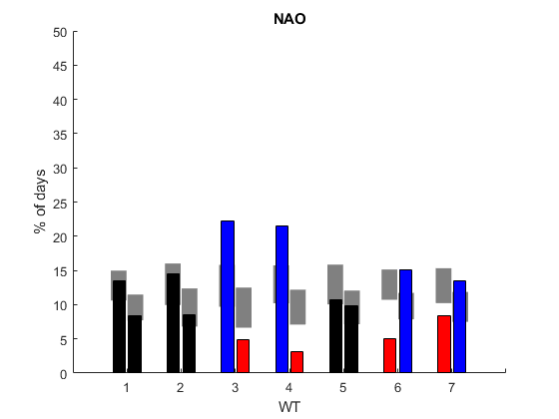
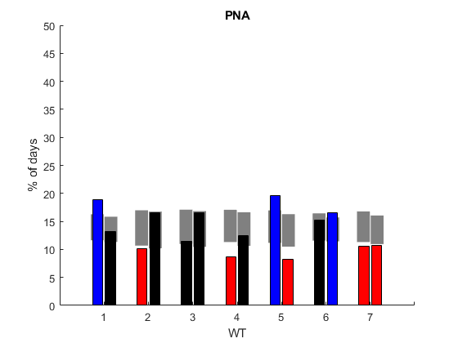
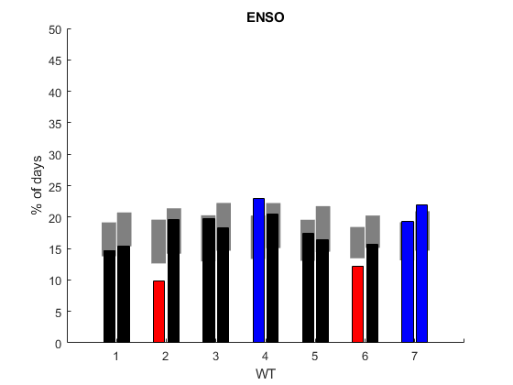
Figure 6. Teleconnection indices (-/+, neutral phases did not show any significance) in relation to each WT. Red shading indicates a WT that is less likely to occur and blue shading indicates a WT that is more likely to occur based on the 95% Monte Carlo confidence level (grey shaded bars).

Slide 7
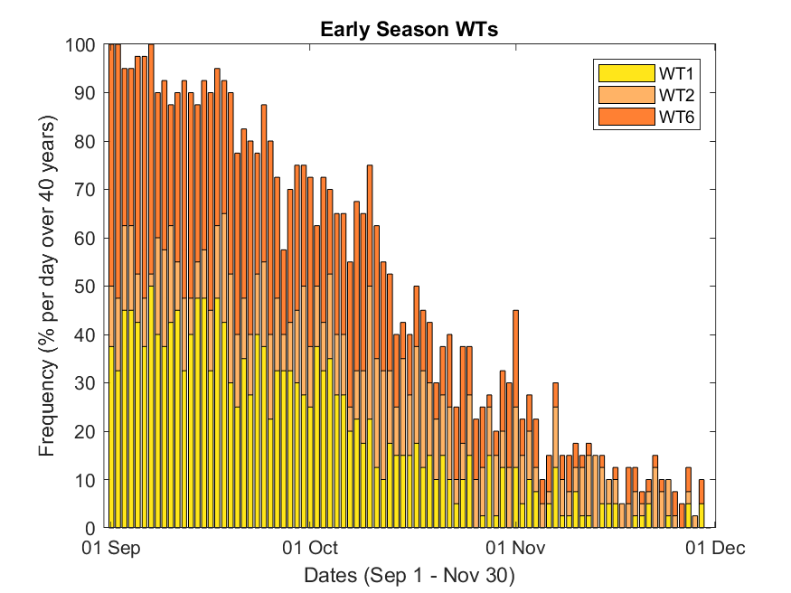
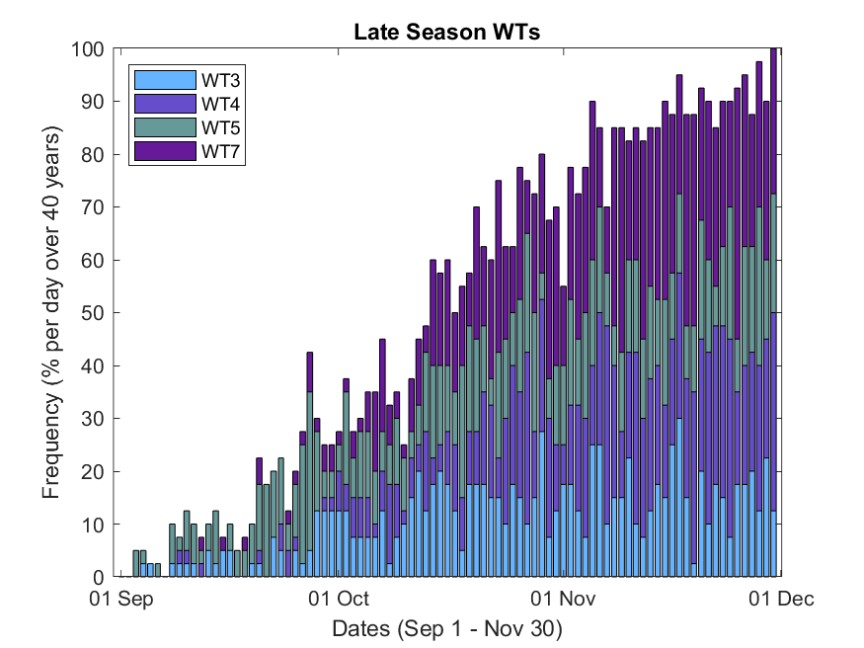
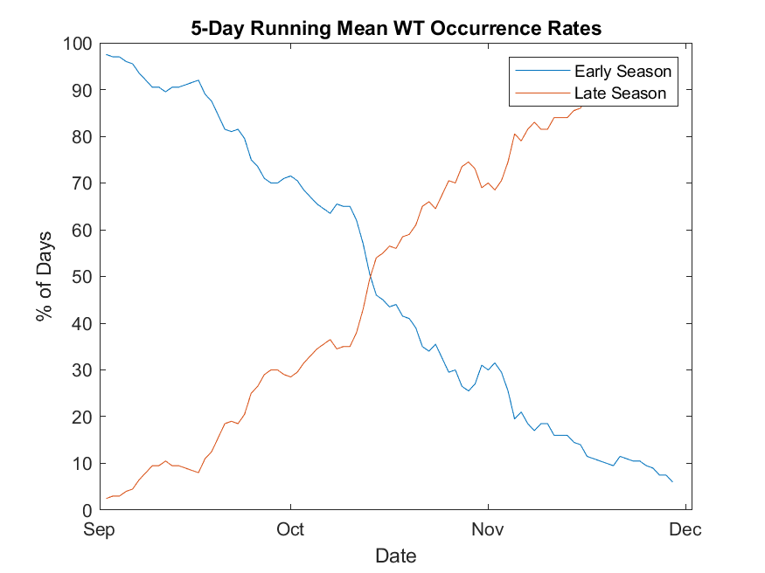
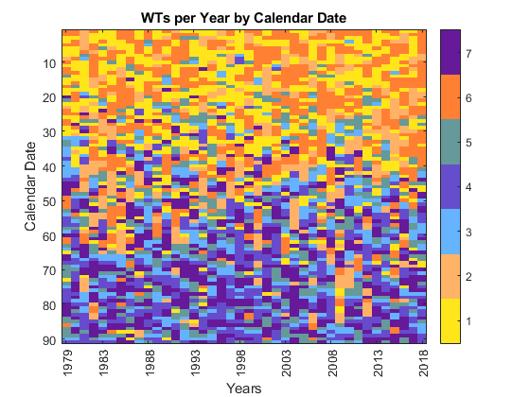
Figure 7. (a,b.) The frequency of occurrence of Early (a) and Late (b) Season WTs on each day of the season over all years. (c) The same as (a) and (b), but smoothed using a 5-day running mean. Note the point of intersection at Oct 15th. (d) Klee diagram showing the WT occurrence per day over all 40 years. Y axis reads from top (Sep 1st) to bottom (Nov 30th)

Slide 8
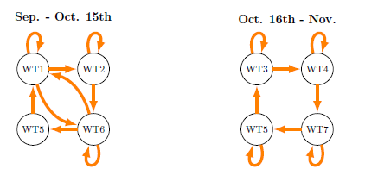
Figure 8. WT progression for the first and second halves of the season based on Markov chain analysis. Arrows indicate progressions that are significant at the 95% level.

Slide 9
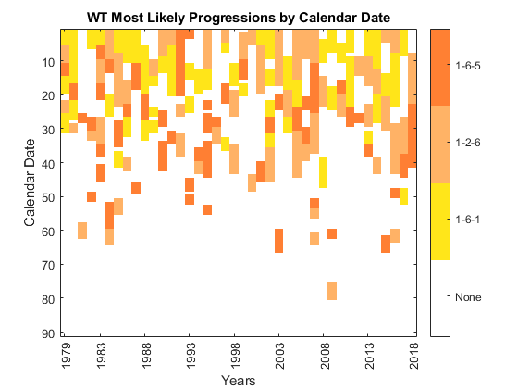
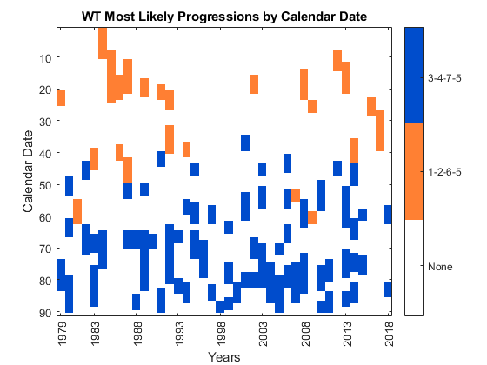
Figure 9. (a) Klee diagram indicating the timing of the most likely WT sequences found using Markov Chain analysis. The Early Season was the only pattern which saw WTs that could progress in chains of 3 (e.g. 1-6-1,1-2-6). (b) Klee diagram indicating the timing of the most likely WT sequences found using Markov Chain analysis.

Slide 10
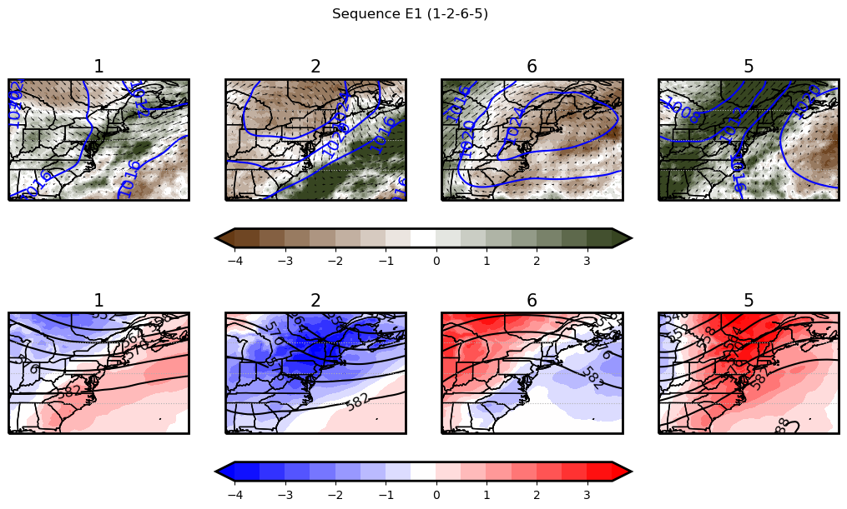
Figure 10. (a,b,c) MSLP (blue), 850 hPa wind, and 2-meter temperature; (d,e,f) 500 hPa height (black) and 2-meter temperature anomaly for WTs in the average 1-2-6-5 sequence.

Slide 11
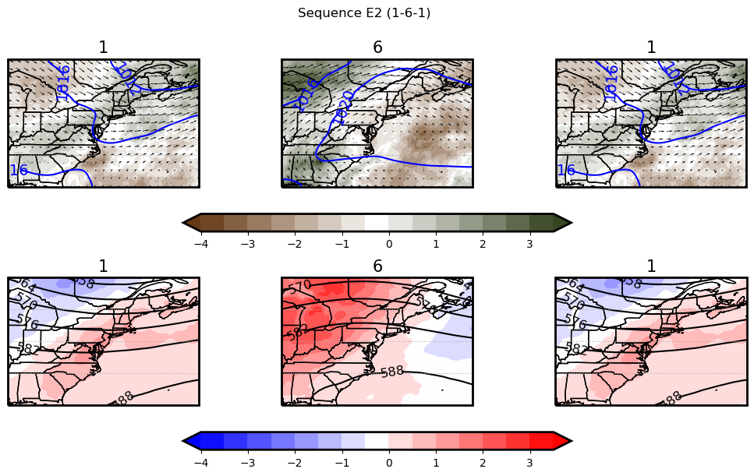
Figure 11. (a,b,c) MSLP (blue) , 850 hPa wind, and 2-meter temperature; (d,e,f) 500 hPa height (black) and 2-meter temperature anomaly for WTs in the average 1-6-1 sequence.

Slide 12
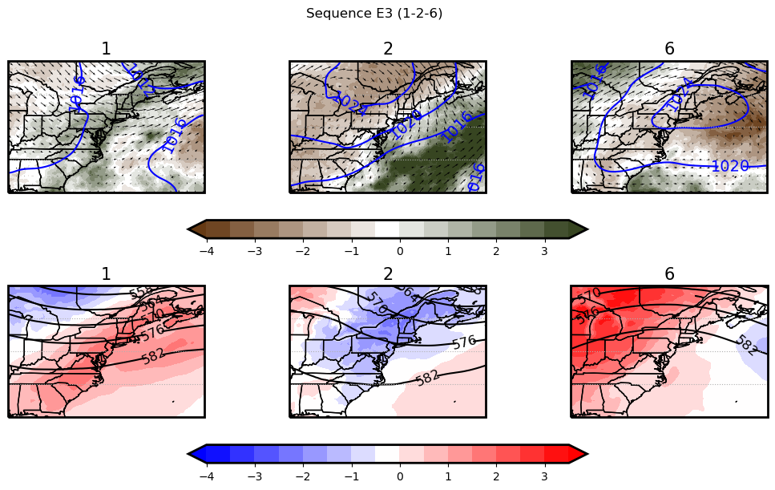
Figure 12. (a,b,c) MSLP (blue), 850 hPa wind, and 2-meter temperature; (d,e,f) 500 hPa height (black) and 2-meter temperature anomaly for WTs in the average 1-2-6 sequence.

Slide 13
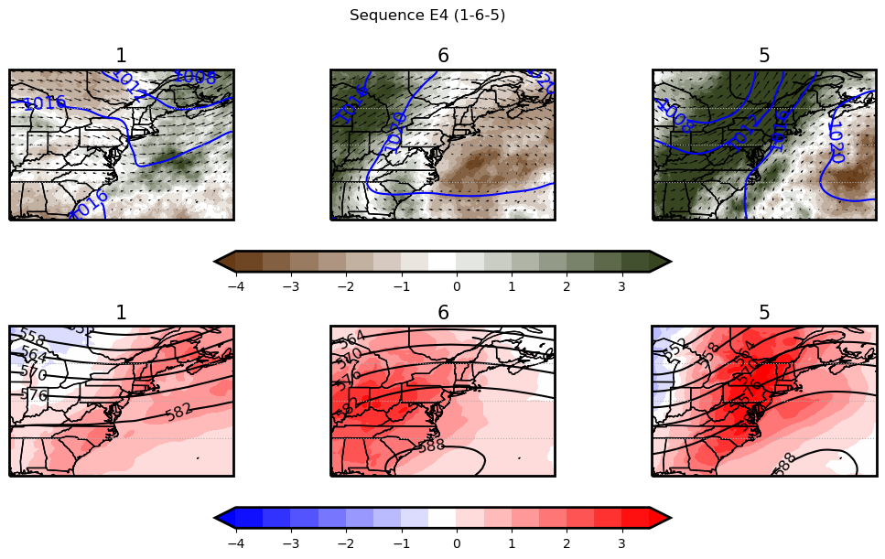
Figure 13. (a,b,c) MSLP (blue), 850 hPa wind, and 2-meter temperature; (d,e,f) 500 hPa height (black) and 2-meter temperature anomaly for WTs in the average 1-6-5 sequence.

Slide 14
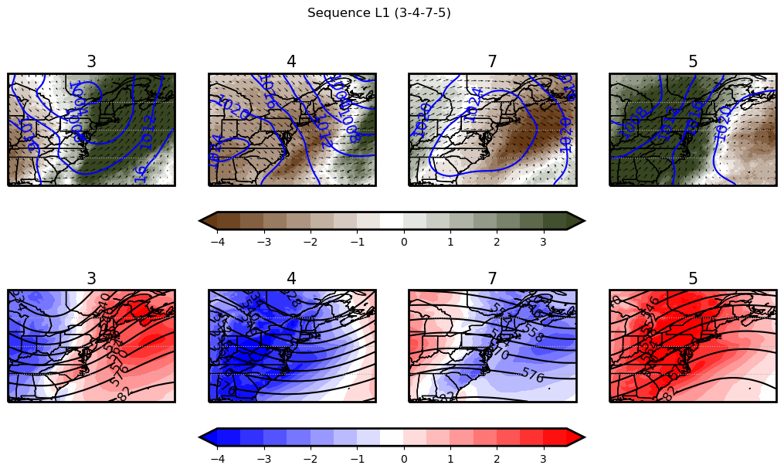
Figure 14. (a,b,c) MSLP (blue), 850 hPa wind, and 2-meter temperature; (d,e,f) 500 hPa height (black) and 2-meter temperature anomaly for WTs in the average 3-4-7-5 sequence.

Slide 15
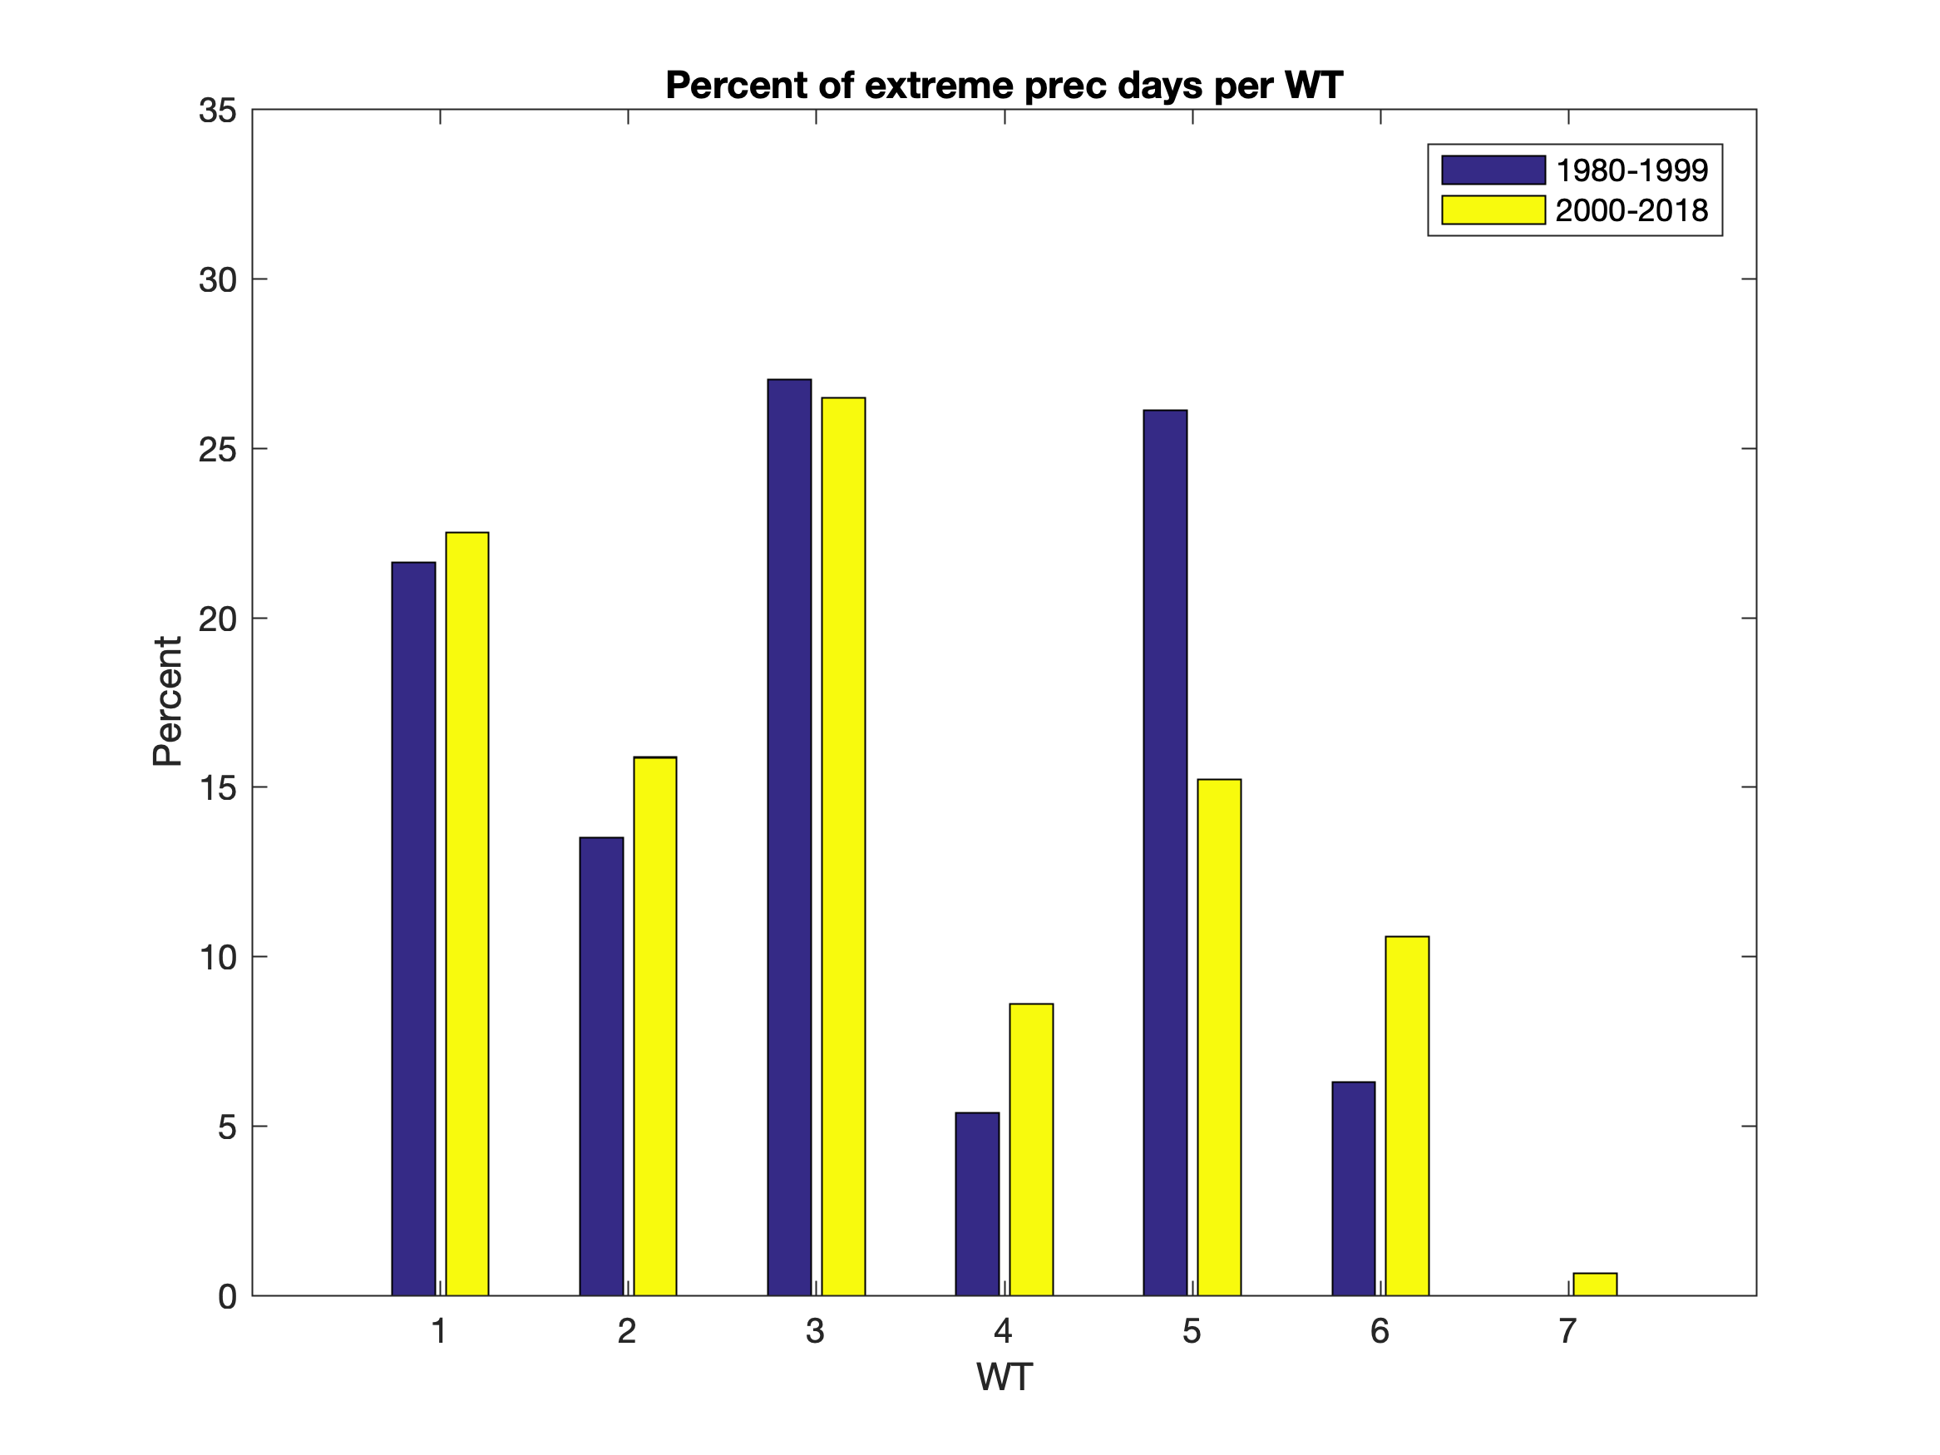
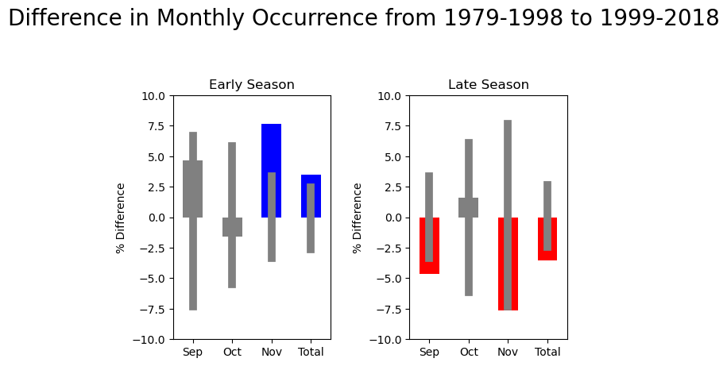
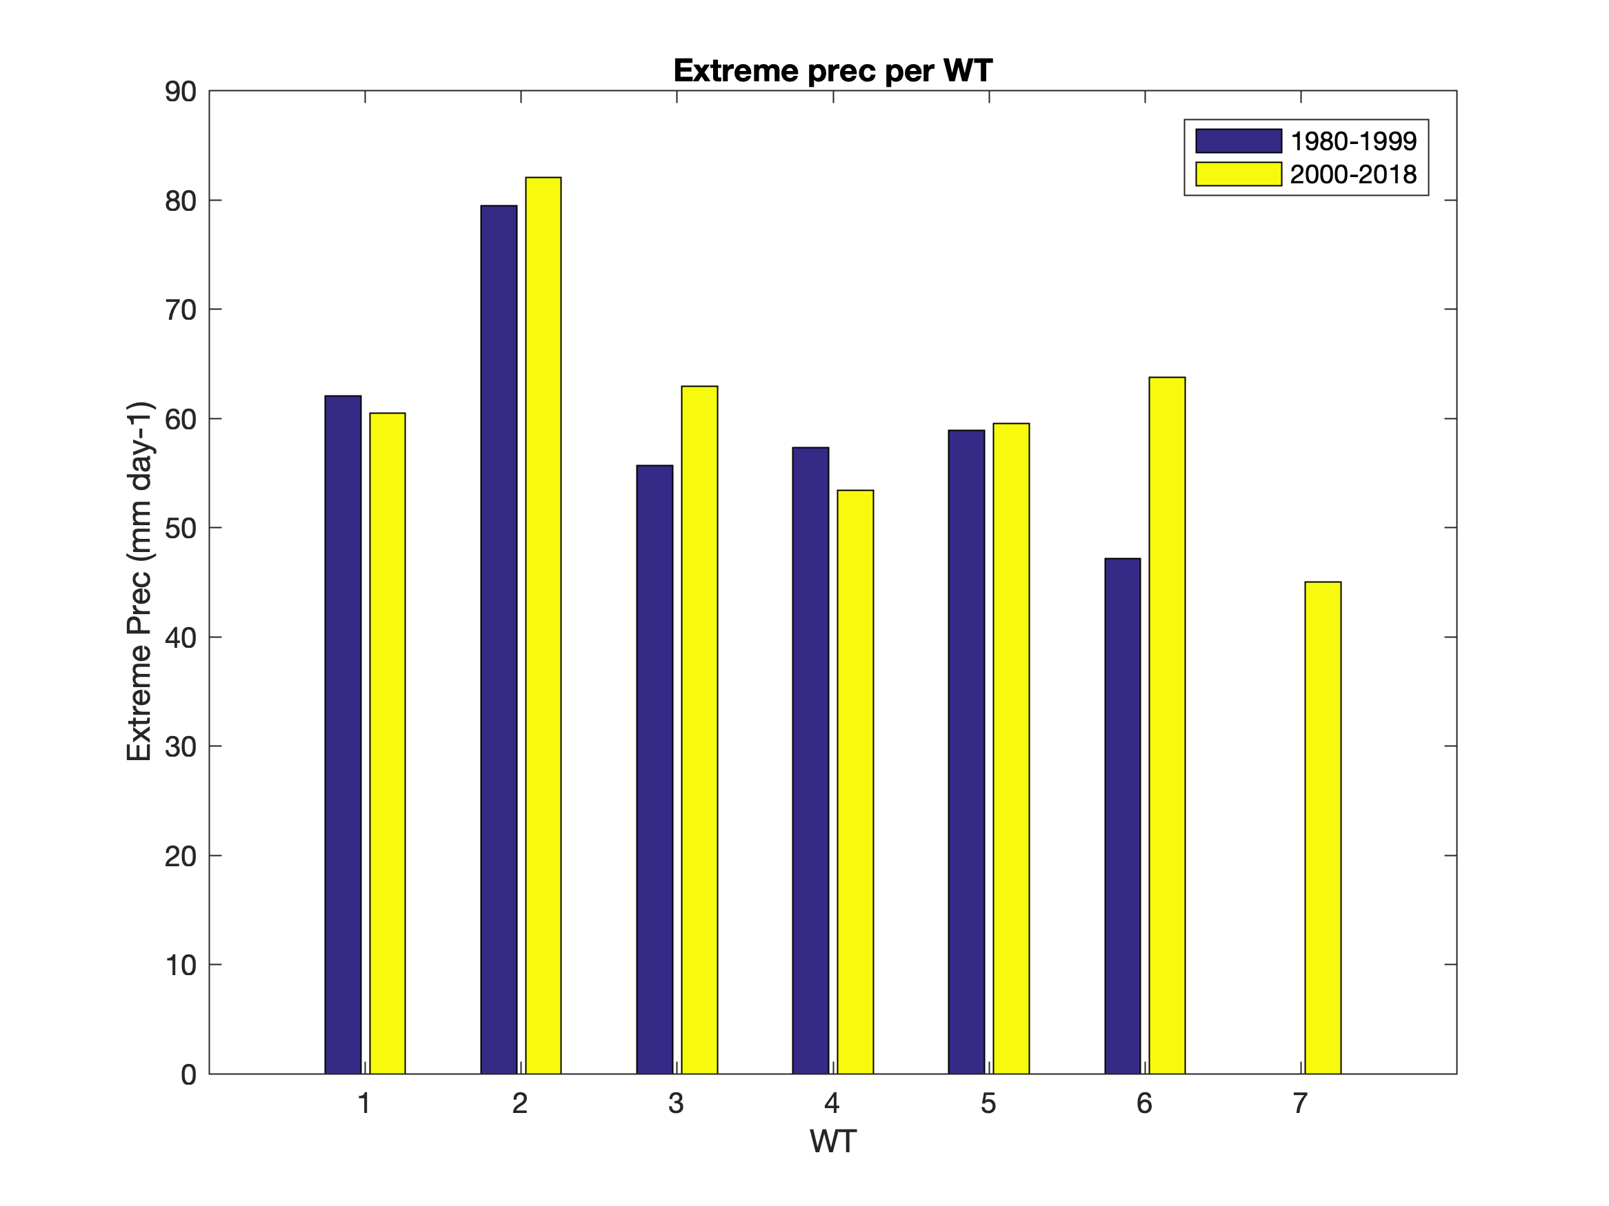
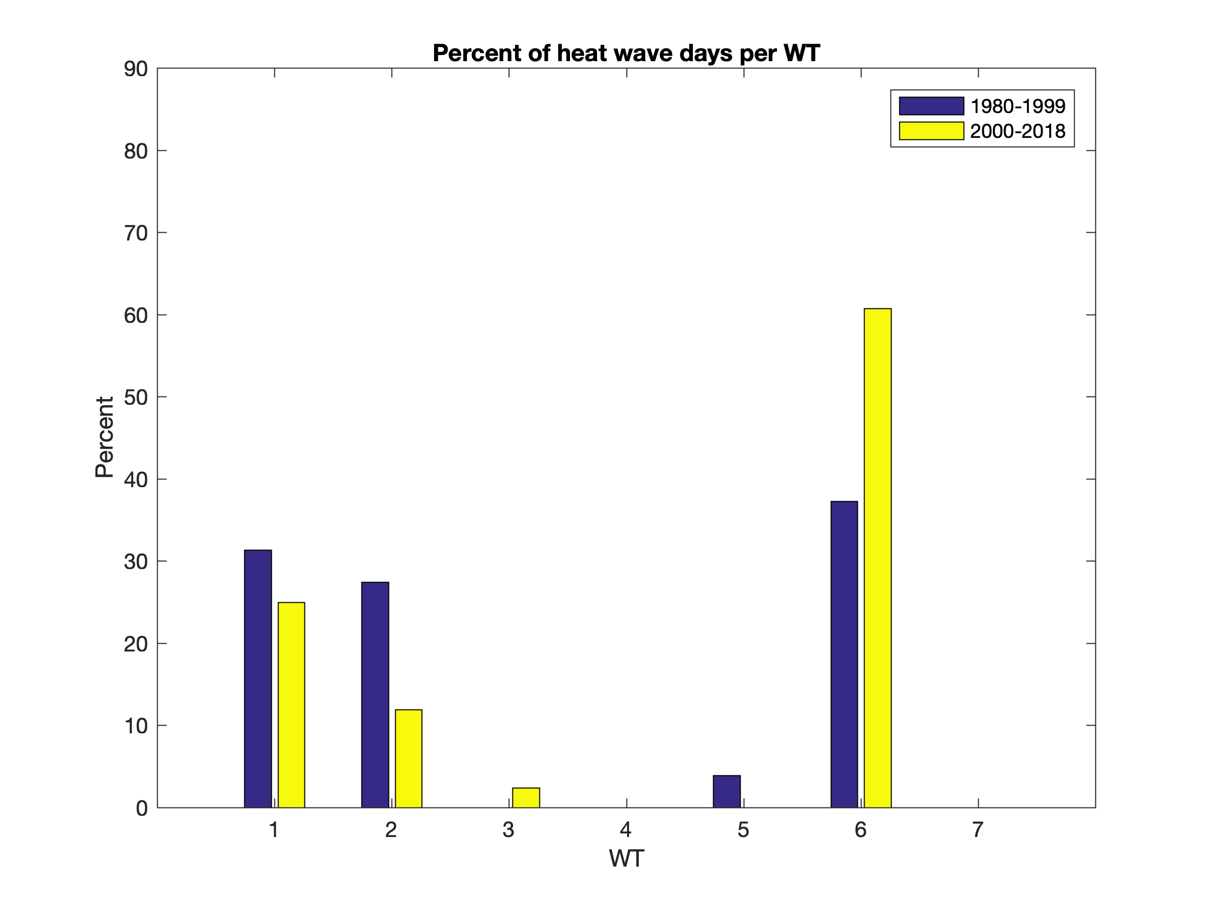
Figure 15. Analysis between the first and second halves of the time period for differences in: (a) frequency of occurrence of Early and Late season WTs. (b) Frequency of extreme precipitation days per WT. (c) Extreme precipitation amount per WT. (d) Frequency of occurrence of heat wave days per WT.

Slide 16






January
February
April
July
September
December

Slide 17
 | Sequence | Count |  | Sequence | Count |  | Sequence | Count
Length 2 Sequences | (6, 1) | 205 | Length 3 Sequences | (1, 2, 6) | 57 | Length 4 Sequences | (5, 3, 4, 7) | 40
 | (7, 4) | 127 |  | (3, 4, 7) | 49 |  | (6, 1, 6, 1) | 27
 | (3, 4) | 114 |  | (1, 6, 1) | 41 |  | (2, 6, 1, 6) | 14
 | (5, 1) | 90 |  | (5, 3, 4) | 38 |  | (6, 1, 2, 6) | 14
 | (2, 6) | 87 |  | (1, 6, 5) | 37 |  | (1, 6, 1, 5) | 13
 | (1, 2) | 82 |  | (5, 4, 7) | 32 |  | (1, 6, 1, 2) | 12
 | (7, 5) | 82 |  | (5, 3, 7) | 30 |  | (5, 1, 2, 6) | 10
Table 2. Top 7 results for occurrences of sequences of length 2, 3, and 4 of WTs in the overall dataset.

Slide 18
Table 3. Markov Chain analysis (as performed in Vautard et al. 1990) indicating WT progression. Table C indicates WTs that are likely to transition between each other, with values below 500 being significant at the 95% level (bold and italicized). Table D indicates WTs that are unlikely to transition between each other, with values below 500 being significant at the 95% level (bold and italicized).

